Slide 1
Hack the Future:
A Gen AI Sprint Powered by Data

Slide 2

Guidelines
The template should consist of the following and it is mandated to be used by your team for submitting your innovative ideas/solutions. Follow file naming format: Team name_Idea Name.pptx

Slide 3




Hack the Future: A Gen AI Sprint Powered by Data
Data and AI Week
Team details
TEAM NAME: DataCrafters_AI
Vamshi Yaski

Slide 4
Entry Submission Summary
Idea Title (Provide a concise and impactful title for your idea.) | Enhancing Job Screening with AI and Data Intelligence
Team Name | DataCrafters_AI
Problem Statement | Current recruitment processes are time-consuming, prone to bias, and struggle with resume-to-JD alignment. There is a lack of intelligent systems that can extract relevant insights from unstructured job data and candidate profiles.
Proposed Solution | We developed a GenAI-based solution powered by local LLMs (Ollama) and a multi-agent system. Our pipeline includes: JD summarization Resume parsing and embedding AI-powered candidate matching SQLite-based shortlisting

Slide 5
Problem statement you are trying to address
Current recruitment processes are time-consuming, prone to bias, and struggle with
resume-to-JD alignment.
There is a lack of intelligent systems that can extract relevant insights from unstructured
job data and candidate profiles.
Manual resume screening is time-consuming and inefficient.
Inconsistent resume formats hinder accurate matching.
Traditional systems rely on keyword-matching, missing context.
Scaling hiring processes with fairness and accuracy is difficult.
Cloud-based AI raises concerns about privacy and cost

Slide 6
Proposed Solution Overview
Brief approach description or methodology used to tackle the problem
I developed an end-to-end AI-powered system using a multi-agent approach:
Job Description Summarizer I used local LLMs (via Ollama) to extract key expectations from lengthy JDs.
Resume Matcher Agent I built an intelligent parser that matches resumes to JDs using semantic embeddings.
On-Premise AI Architecture The system runs entirely locally to ensure privacy, eliminate cloud dependency, and reduce costs.
SQLite Integration Candidate data and match scores are stored in a lightweight SQLite database for quick retrieval.
Simple Flask UI I implemented a user-friendly interface for uploading JDs and resumes, and displaying shortlisted candidates.
This solution enables efficient, accurate, and fair hiring — all developed by a solo contributor.

Slide 7
Technologies Used
List the key technologies, frameworks, and tools you utilized in your solution
🔹 Programming Language
Python – Core scripting for agents, data processing, and automation
🔹 AI & ML Frameworks
Ollama – On-prem LLM for JD summarization and matching
Sentence Transformers – For embedding JDs and resumes
🔹 Backend & DB
Flask – Lightweight web framework for UI
SQLite – Local database for storing candidate-JD matches
🔹 Resume & JD Processing
PyMuPDF – PDF text extraction from resumes
TextRank / Custom NLP – For JD summarization logic
🔹 Tools & Utilities
OBS Studio – For recording the demo video
GitHub – For version control and code repository
Logging – For tracking system operations and debugging

Slide 8
Agents' interaction design
1️⃣ JD Summarizer Agent
Input: Raw Job Description text
Function:
Uses Ollama-based LLM to extract role expectations
Outputs a concise summary focusing on key responsibilities and skills
2️⃣ Resume Matcher Agent
Input:
Parsed resume content (PDF)
Summary from JD Summarizer
Function:
Embeds both using Sentence Transformers
Computes semantic similarity score
Shortlists resumes above a defined threshold

Slide 9
Code structure
📁 agents/
├── jd_summarizer.py # Extracts key points from job descriptions using Ollama
└── resume_matcher.py # Parses and matches resumes to JD summaries
📁 data/
├── samples_jds/ # Sample job descriptions (text files)
└── sample_resumes/ # Sample resumes (PDFs)
📁 database/
└── db_handler.py # SQLite database setup and query logic
📄 job_screening.db # SQLite database storing matches
📄 app.py # Flask application for UI and agent integration
📄 requirements.txt # List of dependencies (Flask, PyMuPDF, Sentence Transformers, etc.)
📄 README.md # Project overview and setup instructions

Slide 10
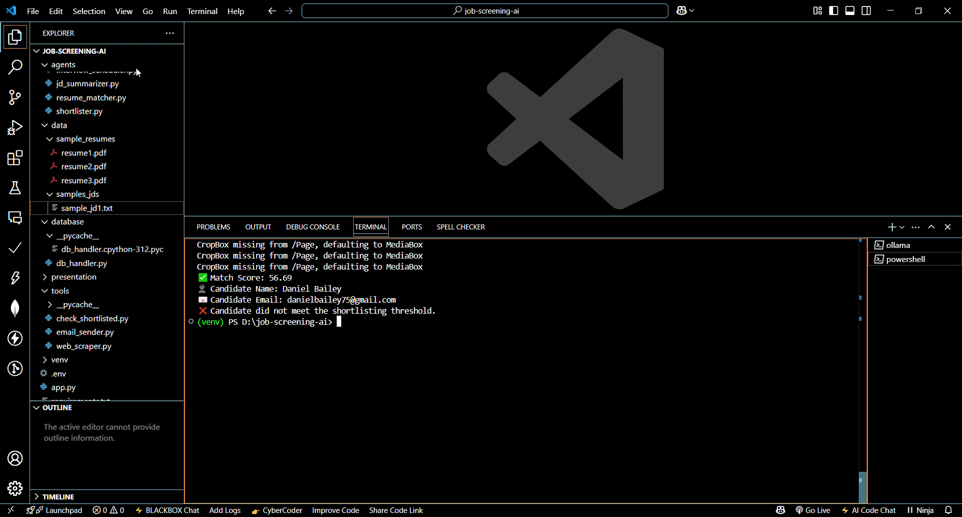
Demo video

Slide 11
Conclusion
Summarize the impact and effectiveness of your solution. Reiterate how it solves the problem statement.
It addresses the core challenges in hiring: time-consuming resume screening, inconsistent formats, and lack of
contextual matching.
By using local LLMs, semantic matching, and automation, it ensures fast, fair, and privacy-preserving candidate
shortlisting.
The system is scalable, accurate, and cost-effective, making it a practical solution for modern recruitment needs.
This project demonstrates an AI-powered, on-premise job screening system built by a single contributor.
Overall, it significantly reduces recruiter workload and improves the quality of hiring decisions.

Slide 12
References/Other details
Ollama: https://ollama.com
SQLite: https://sqlite.org
Flask: https://flask.palletsprojects.com
Ethical scraping guidelines: https://docs.python-guide.org/scenarios/scrape/

Slide 13
Thank You

